Slide 1
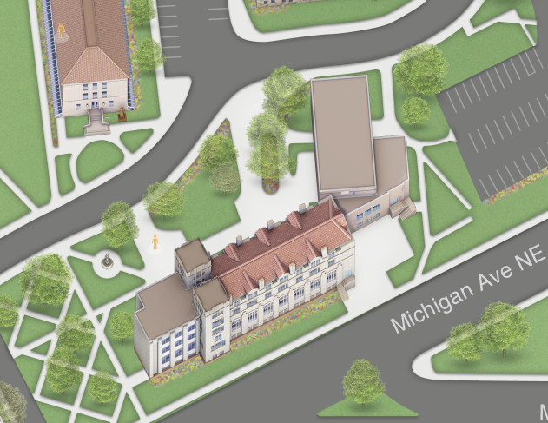
Senior Thesis Presentation
Penn State University
Kevin Andreone
Mechanical Option
Advisor: Dr. Laura Miller

Slide 2
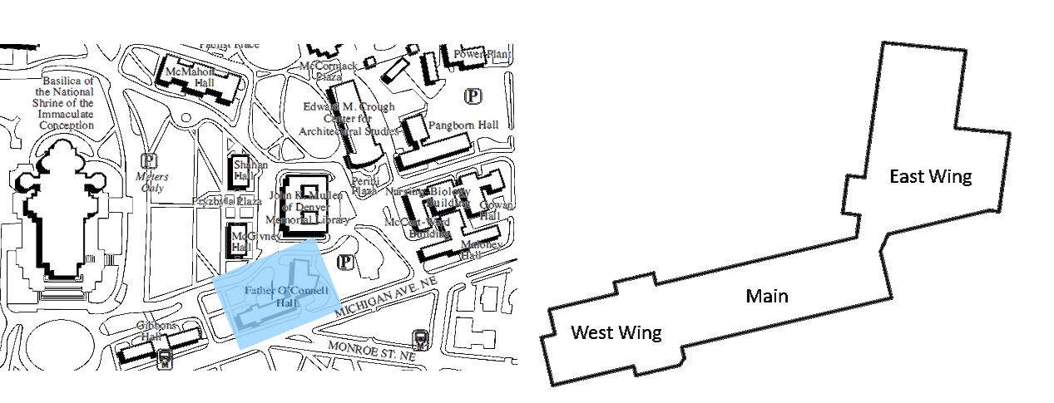
Building Overview
Introduction
Building Overview
Existing Mechanical
Combined Heat and Power Analysis
Electrical Breath
Recommendations
Acknowledgments
Questions
General Building Data
Location:
Size:
Height:
Construction Dates:
Cost:
Occupancy
Project Team
Owner:
Architect:
MEP/FP Engineer:
Structural Engineer:
Civil Engineer:
Project Management:
Washington, DC
54,000 GSF
4 Stories above grade, 1 below
July 2013-May 2014
15 million
Administrative/Office
Catholic University of America
SmithGroupJJR
SmithGroupJJR
McMullan & Associates, Inc.
ADTEK
Mark G Anderson Consultants, Inc.
Site Analysis

Slide 3
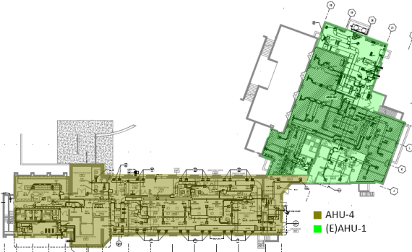
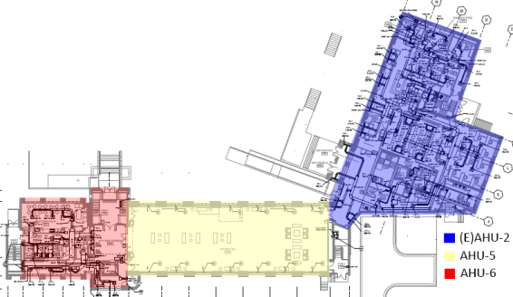
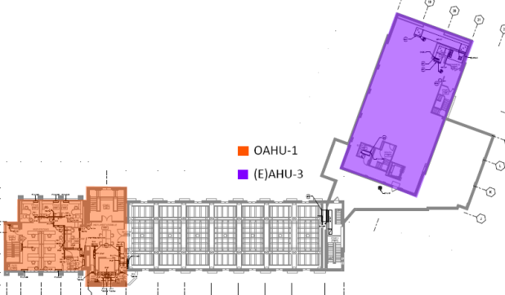
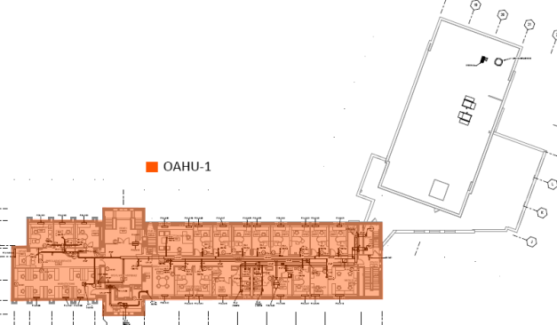
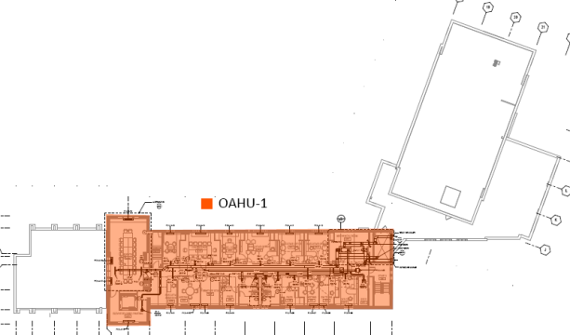
Existing Mechanical Systems
Introduction
Building Overview
Existing Mechanical
Combined Heat and Power Analysis
Electrical Breath
Recommendations
Acknowledgments
Questions
Basement Floor
1st Floor
Air-Side
3 Existing AHU’s
East wing not in scope
AHU-4 and AHU-6
Use VAV and Fan powered boxes with hot water reheat in basement and first floors
AHU-5
Displacement ventilation on first floor for two story banquet hall
OAHU-1
Dedicated Outdoor AHU
Ventilates floors 2-4 and uses 4 pipe Fan Coil Units
2nd Floor
3rd Floor
4th Floor
(E)-Existing

Slide 4
Existing Mechanical Systems
Introduction
Building Overview
Existing Mechanical
Combined Heat and Power Analysis
Electrical Breath
Recommendations
Acknowledgments
Questions
Basement Floor
1st Floor
Water-Side
Cooling
One 97.7 ton electric air-cooled chiller
Two chilled water pumps with VFD’s
Heating
Two 500 MBH Condensing Boilers
84% Efficient
Low Pressure (2psi) 2 inch gas pipe provided by Washington Gas Company
Three hot water pumps with VFD’s
2nd Floor
3rd Floor
4th Floor
(E)-Existing

Slide 5
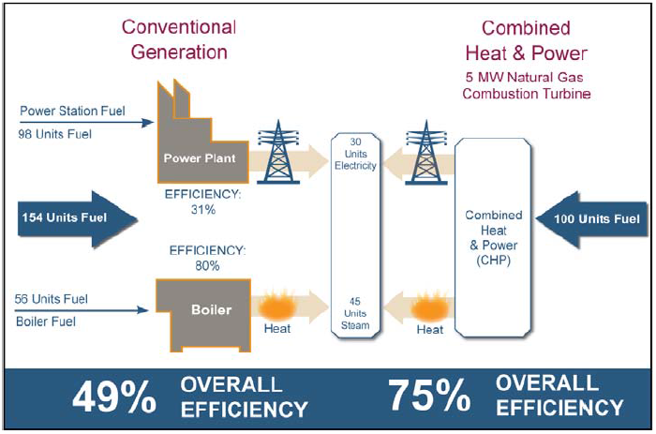
CHP Introduction
Introduction
Combined Heat and Power Analysis
CHP Introduction
Building Demands Profiles
CHP Demands
Primary Fuel Utilization Efficiency
Cost Analysis
Emissions
Electrical Breath
Conclusion
Acknowledgments
Questions
Introduction
CHP Goals
Simultaneous production of heat and power with on-site generation
Reliable power during grid blackout or brownout
Higher overall efficiencies
Lower emissions
Absorption Cooling Goals
Utilize waste heat in summer months
Reduce existing chiller size
Reduce power demand in summer months

Slide 6
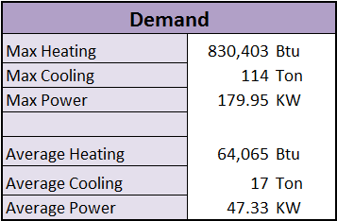
Building Demand Profiles
Introduction
Combined Heat and Power Analysis
CHP Introduction
Building Demands Profiles
CHP Demands
Primary Fuel Utilization Efficiency
Cost Analysis
Emissions
Electrical Breath
Conclusion
Acknowledgments
Questions
Spark Gap
Difference between price of natural gas and electricity
Demands
Thermal to power ratio
λ_{D} = Qq
Qe
Driving factor

Slide 7
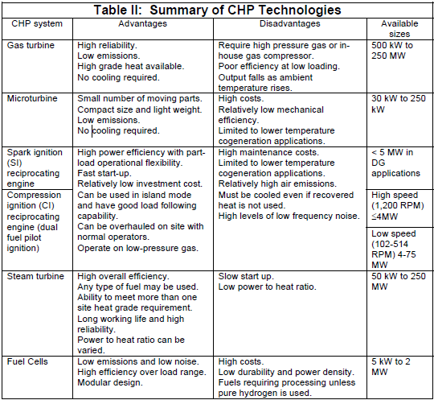
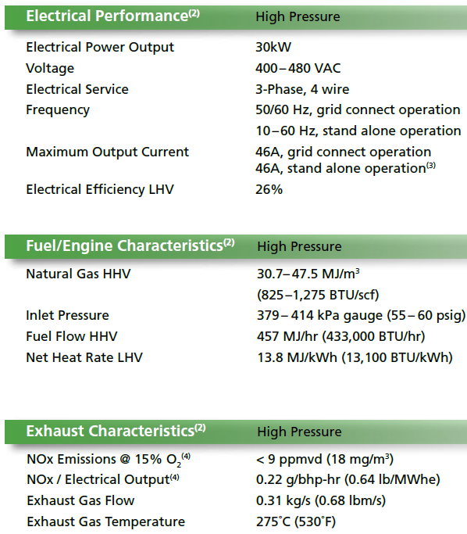
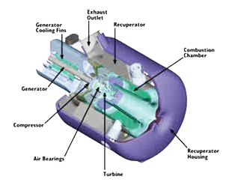
Prime Movers
Introduction
Combined Heat and Power Analysis
CHP Introduction
Building Demands Profiles
CHP Demands
Primary Fuel Utilization Efficiency
Cost Analysis
Emissions
Electrical Breath
Conclusion
Acknowledgments
Questions
Microturbine
Produce lowest power(15-250KW)
Low electrical Efficiency
Low Maintenance Cost
Low emissions
Capstone C30 Microturbine
Table from EPA

Slide 8
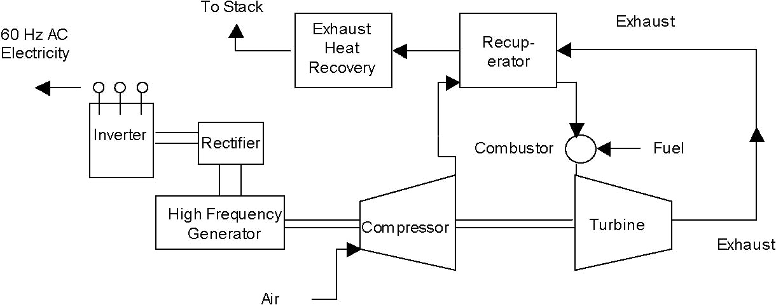
Prime Movers
Introduction
Combined Heat and Power Analysis
CHP Introduction
Building Demands Profiles
CHP Demands
Primary Fuel Utilization Efficiency
Cost Analysis
Emissions
Electrical Breath
Conclusion
Acknowledgments
Questions
Microturbine
Produce lowest power(15-250KW)
Low electrical Efficiency
Low Maintenance Cost
Low emissions
Capstone C30 Microturbine

Slide 9
Net Heat Rate
Introduction
Combined Heat and Power Analysis
CHP Introduction
Building Demands Profiles
CHP Demands
Primary Fuel Utilization Efficiency
Cost Analysis
Emissions
Electrical Breath
Conclusion
Acknowledgments
Questions
Microturbine
Produce lowest power(15-250KW)
Low electrical Efficiency
Low Maintenance Cost
Low emissions
Capstone C30 Microturbine

Slide 10
Net Heat Rate
Introduction
Combined Heat and Power Analysis
CHP Introduction
Building Demands Profiles
CHP Demands
Primary Fuel Utilization Efficiency
Cost Analysis
Emissions
Electrical Breath
Conclusion
Acknowledgments
Questions
Microturbine
Produce lowest power(15-250KW)
Low electrical Efficiency
Low Maintenance Cost
Low emissions
Capstone C30 Microturbine

Slide 11
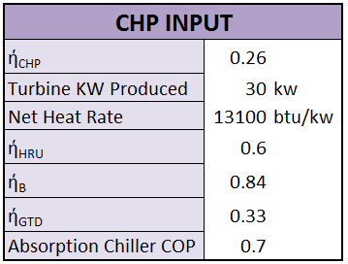
Heating Demands
Introduction
Combined Heat and Power Analysis
CHP Introduction
Building Demands Profiles
CHP Demands
Primary Fuel Utilization Efficiency
Cost Analysis
Emissions
Electrical Breath
Conclusion
Acknowledgments
Questions
January Sample Calculations

Slide 12
Cooling Demands
Introduction
Combined Heat and Power Analysis
CHP Introduction
Building Demands Profiles
CHP Demands
Primary Fuel Utilization Efficiency
Cost Analysis
Emissions
Electrical Breath
Conclusion
Acknowledgments
Questions
January Sample Calculations

Slide 13
Power Demands
Introduction
Combined Heat and Power Analysis
CHP Introduction
Building Demands Profiles
CHP Demands
Primary Fuel Utilization Efficiency
Cost Analysis
Emissions
Electrical Breath
Conclusion
Acknowledgments
Questions
January Sample Calculations

Slide 14
Useful Waste Heat
Introduction
Combined Heat and Power Analysis
CHP Introduction
Building Demands Profiles
CHP Demands
Primary Fuel Utilization Efficiency
Cost Analysis
Emissions
Electrical Breath
Conclusion
Acknowledgments
Questions
January Sample Calculations

Slide 15
Primary Fuel Utilization Efficiency
Introduction
Combined Heat and Power Analysis
CHP Introduction
Building Demands Profiles
CHP Demands
Primary Fuel Utilization Efficiency
Cost Analysis
Emissions
Electrical Breath
Conclusion
Acknowledgments
Questions
CHP vs SHP
PEUF _{SHP}= η_{GTD}η_{B}(1 + λ _{D})
η_{B} + η_{GTD}λ _{D}
PEUF _{CHP}= η_{eCHP}( 1 + λ _{D})
PEUF _{Hybrid} = η_{CHP}η_{GTD}η_{B} (1 + λ_{D} )
(η_{CHP}η_{B}f_{eD},_{GTD} + η_{GTD}η_{B}f_{eD},_{CHP} + η_{GTD}η_{CHP} λ _{QD, B}
CHP INPUT
ή_{CHP} | 0.26
KW Produced | 30 | kw
Net Heat Rate | 13100 | btu/kw
ή_{HRU} | 0.6
ή_{B} | 0.84
ή_{GTD} | 0.33
Absorption Chiller COP | 0.7

Slide 16
Primary Fuel Utilization Efficiency
Introduction
Combined Heat and Power Analysis
CHP Introduction
Building Demands Profiles
CHP Demands
Primary Fuel Utilization Efficiency
Cost Analysis
Emissions
Electrical Breath
Conclusion
Acknowledgments
Questions
Primary Fuel Utilization Efficiency (PUEF)
λ_{D} < 0.7 SHP has a higher PUEF
λ_{D} > 0.7 CHP has a higher PUEF
λ_{D} > 1.7 start over producing electricity and start to lose money
λ_{D} = 2.3 maximum PUEF and percent fuel savings ratio
λ_{D} < 2.3 start supplemental boiler and PFESR starts to decline but still positive
CHP INPUT
ή_{CHP} | 0.26
KW Produced | 30 | kw
Net Heat Rate | 13100 | btu/kw
ή_{HRU} | 0.6
ή_{B} | 0.84
ή_{GTD} | 0.33
Absorption Chiller COP | 0.7

Slide 17
Primary Fuel Utilization Efficiency
Introduction
Combined Heat and Power Analysis
CHP Introduction
Building Demands Profiles
CHP Demands
Primary Fuel Utilization Efficiency
Cost Analysis
Emissions
Electrical Breath
Conclusion
Acknowledgments
Questions
Primary Fuel Utilization Efficiency (PUEF)
λ_{D} < 0.7 SHP has a higher PUEF
λ_{D} > 0.7 CHP has a higher PUEF
λ_{D} > 1.7 start over producing electricity and start to lose money
λ_{D} = 2.3 maximum PUEF and percent fuel savings ratio
λ_{D} < 2.3 start supplemental boiler and PFESR starts to decline but still positive
CHP INPUT
ή_{CHP} | 0.26
KW Produced | 30 | kw
Net Heat Rate | 13100 | btu/kw
ή_{HRU} | 0.6
ή_{B} | 0.84
ή_{GTD} | 0.33
Absorption Chiller COP | 0.7

Slide 18
Cost Analysis
Introduction
Combined Heat and Power Analysis
CHP Introduction
Building Demands Profiles
CHP Demands
Primary Fuel Utilization Efficiency
Cost Analysis
Emissions
Electrical Breath
Conclusion
Acknowledgments
Questions
Cost Analysis

Slide 19
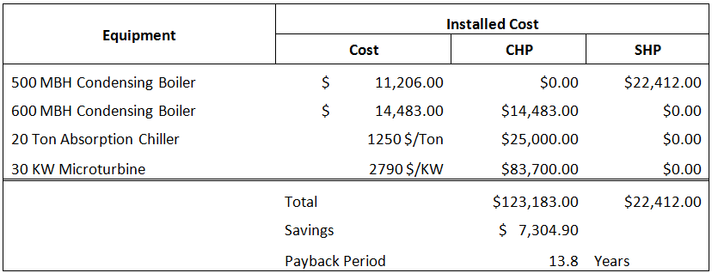
Cost Analysis
Introduction
Combined Heat and Power Analysis
CHP Introduction
Building Demands Profiles
CHP Demands
Primary Fuel Utilization Efficiency
Cost Analysis
Emissions
Electrical Breath
Conclusion
Acknowledgments
Questions
Payback Period

Slide 20
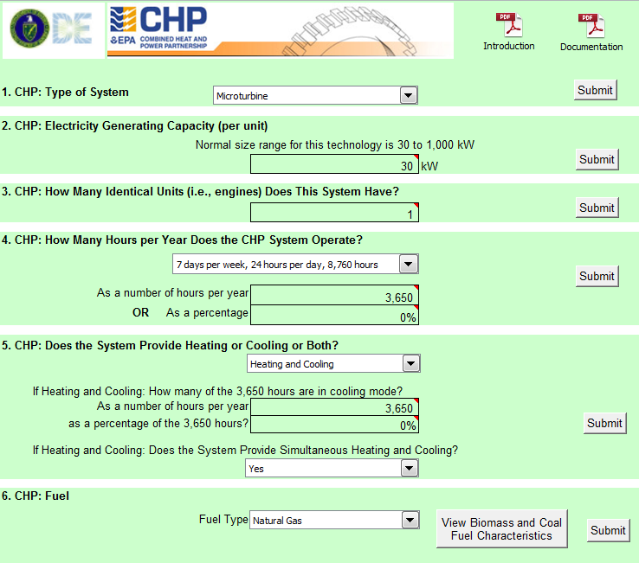
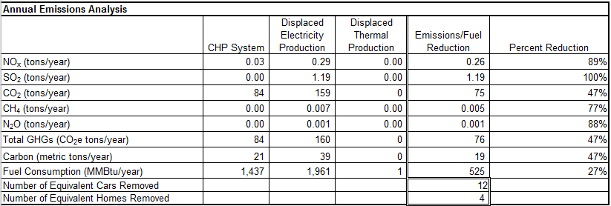
Emissions
Introduction
Combined Heat and Power Analysis
CHP Introduction
Building Demands Profiles
CHP Demands
Primary Fuel Utilization Efficiency
Cost Analysis
Emissions
Electrical Breath
Conclusion
Acknowledgments
Questions
Emissions
Emissions Spreadsheet from EPA

Slide 21
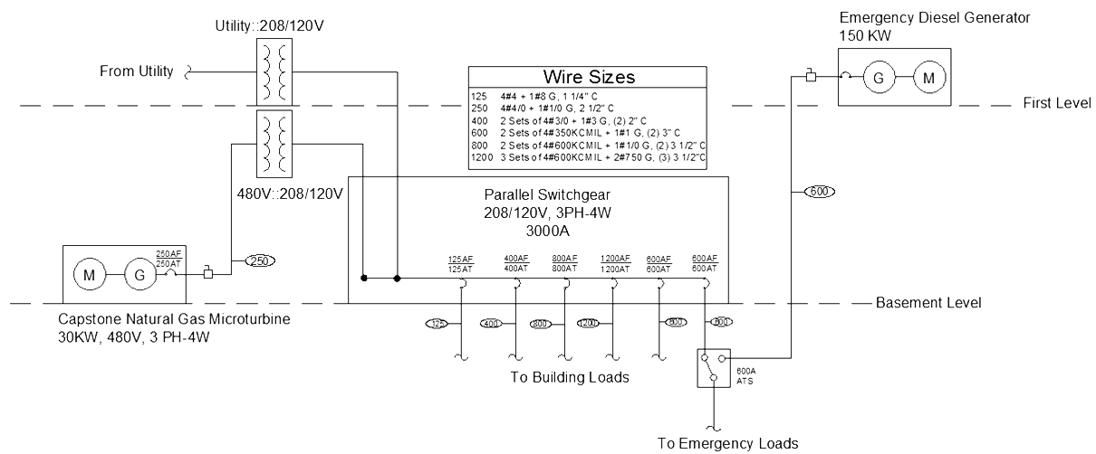
Electrical Breadth
Introduction
Combined Heat and Power Analysis
Electrical Breath
Recommendations
Acknowledgments
Questions
Power Connection
Replace Switchgear with Parallel Switchgear
208/120V, 3PH-4W 3000A
Syncs power from two sources
Add 480V:208/120V transformer
Size wires and breakers
Emergency Power
150 KW emergency generator
Duel fuel microturbine to replace emergency generator
Reduce payback period

Slide 22
Recommendations
Introduction
Combined Heat and Power Analysis
Electrical Breath
Recommendations
Acknowledgments
Questions
Recommendations
Economically
Do not recommend CHP System
14 year payback period
Not enough heat load
Environmentally
Recommend CHP system
Save 27% Fuel Consumption
Reduce Carbon footprint by 47%

Slide 23
Acknowledgments
Introduction
Combined Heat and Power Analysis
Electrical Breath
Recommendations
Acknowledgments
Questions
Thank You!
Dr. Laura Miller – AE Senior Thesis Advisor
SmithGroupJJR
Dr. James Freihaut – Help with CHP systems
AE Faculty and Students
Friends and Family

Slide 24
Questions
Introduction
Combined Heat and Power Analysis
Electrical Breath
Recommendations
Acknowledgments
Questions
Questions?

Slide 25
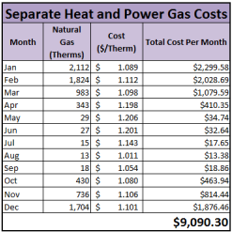
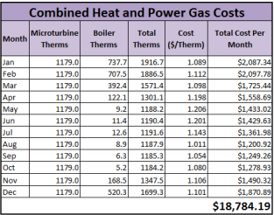
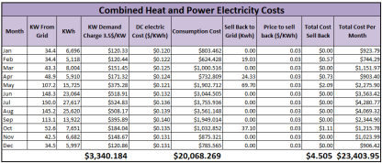
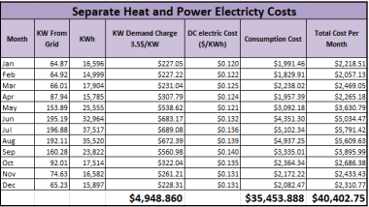
Questions
Cost Analysis

